Slide 1
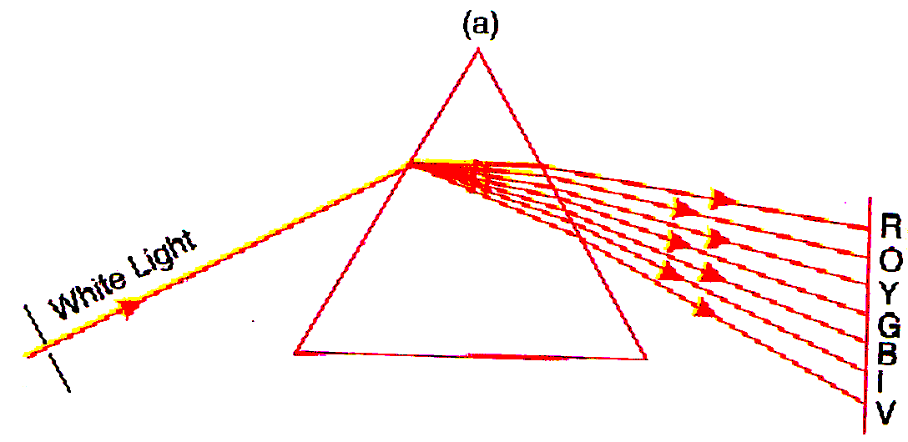
dISPERSION
Dispersion by A Prism

Slide 2
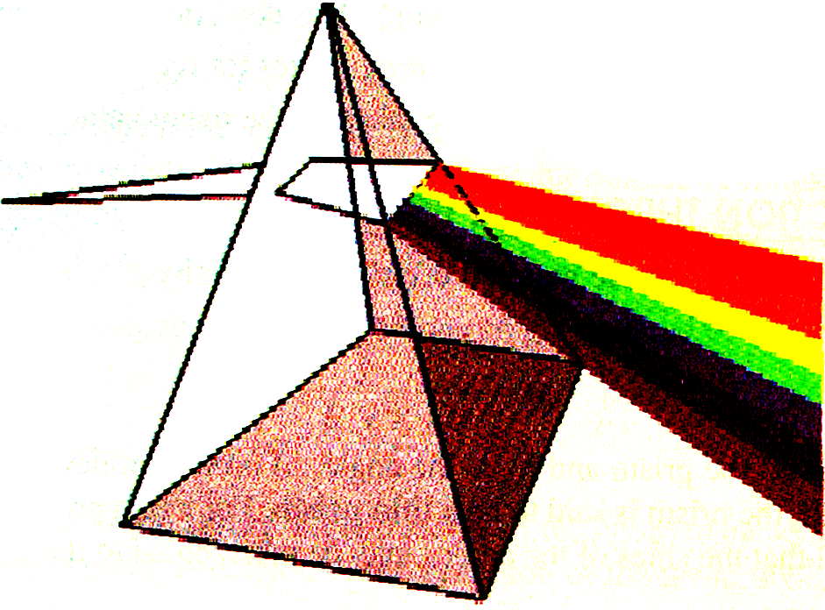
Light splitting up into its constituent colours

Slide 3
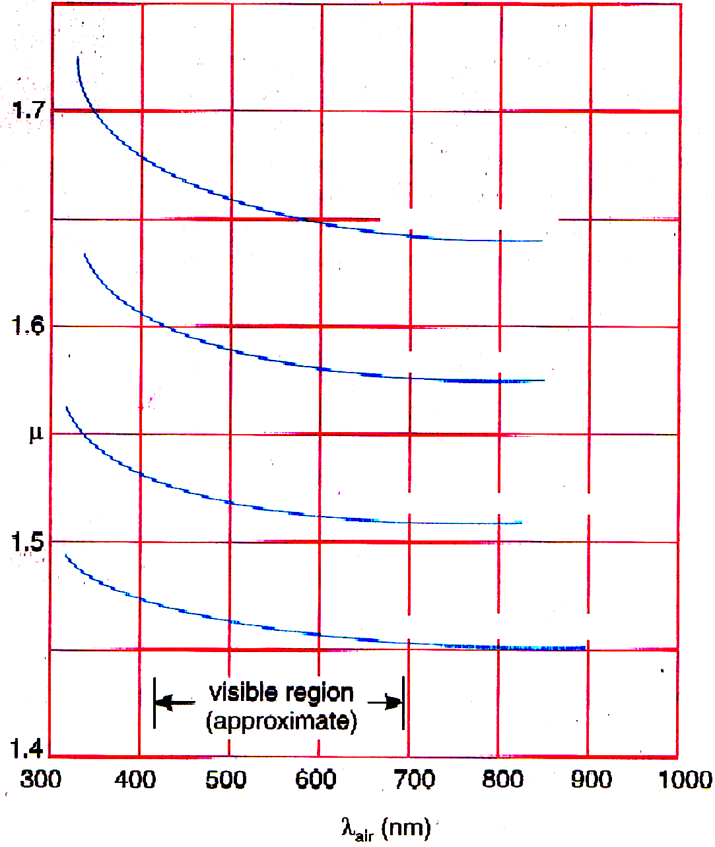

Slide 4
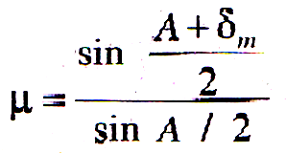
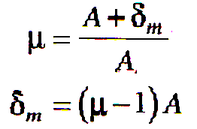
Refraction through a prism
The refractive index of the material of prism is given by

Slide 5
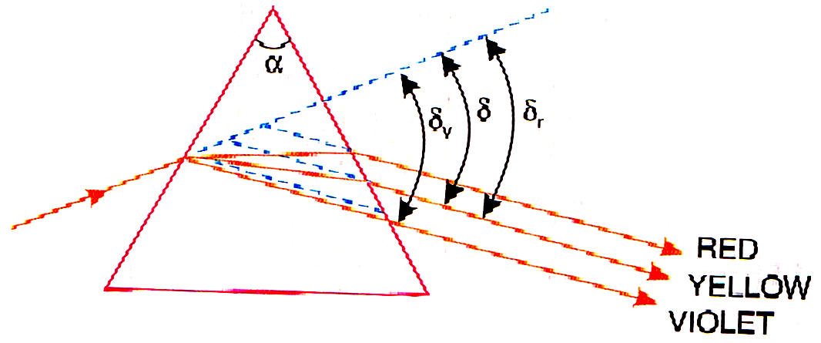
Angular dispersion
The deviation δ_{V} , δ and δ_{R} can be written as
δ = (μ - 1) A
δ_{V} = (μ_{v} – 1) A
δ_{R} = (μ_{R} – 1) Aθ
θ = δ_{v} – δ_{R} = (μ_{v} – μ_{R}) A

Slide 6
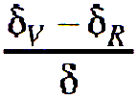
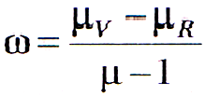
Dispersive power
Dispersive power indicates the ability of the material of the prism to disperse the light rays. It is defined as the ratio of the angular dispersion to the deviation of the mean ray.
Dispersive power, ω =

Slide 7
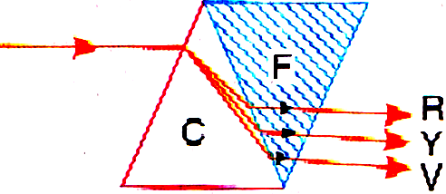
Achromatic combination of prisms – deviation without dispersion
An achromatic prism is a combination of two appropriate prisms so constructed that it shows no colours. It is noted that the dispersive powers of different materials are different. Flint glasses have higher dispersive power than crown glasses. Hence, it is possible to combine two prisms of different materials and specified angles such that a ray of white light may pass through the combination without dispersion, though it may suffer deviation. Such a combination is called an achromatic combination.

Slide 8
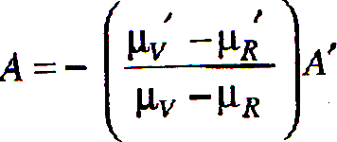
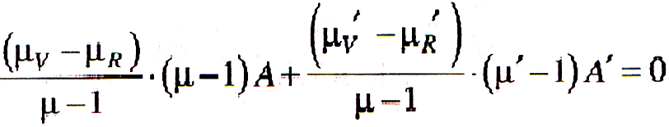
δ_{V} – δ_{R} = (μ_{V} – μ_{R}) A
For achromatism the net angular dispersion produced by the two prisms together must be zero.
∴ (μ_{V} – μ_{R}) A + (μ _{V}’ – μ_{R}’) A’ = 0
This is the condition for achromatism
∴
ωδ = ω‘δ’

Slide 9
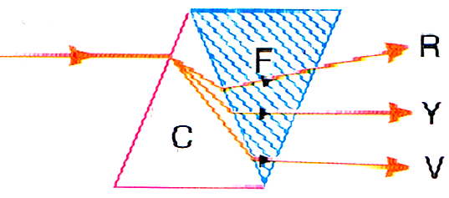
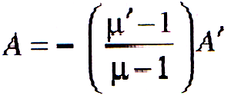
Dispersion without deviation
δ = (μ – 1) A
δ’ = (μ’ – 1) A’
The net deviation produced by the prism combination is to be zero.
That is, δ = δ’ = 0
Or (μ - 1) A + (μ‘ – 1) A’ = 0
∴

Slide 10
The total deviation for the violet rays is given by
δ_{V} = (μ_{V} – 1) A + (μ_{V}’ – 1) A’
The total deviation for the red rays is given by
δ_{R} = (μ_{R} – 1) A + (μ_{R}’ – 1) A’
Hence the total dispersion is equal to
δ_{V} - δ_{R} = (μ_{V} – μ_{R}) A + (μ_{V}’ – μ_{V}’ ) A’
It follows from that
δ_{V} - δ_{R} = (ω – ω’) (μ – 1 ) A
Thus the resultant dispersion is equal to the difference between the two dispersions.

Slide 11
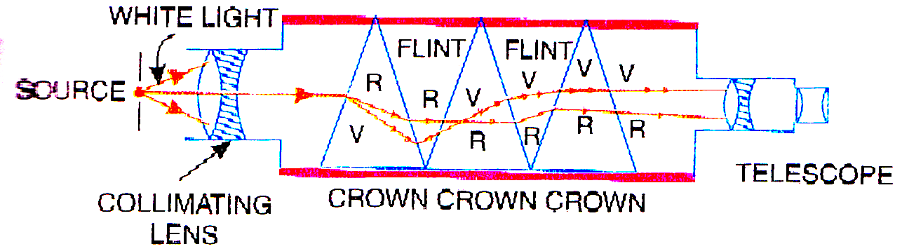
DIRECT VISION SPECTROSCOPE

Slide 12
The END

