Slide 1
Entropy
Atreyi Paul
Department of Physics

Slide 2
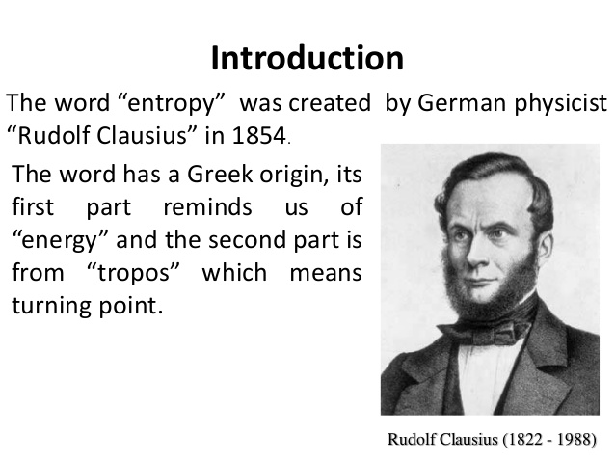

Slide 3
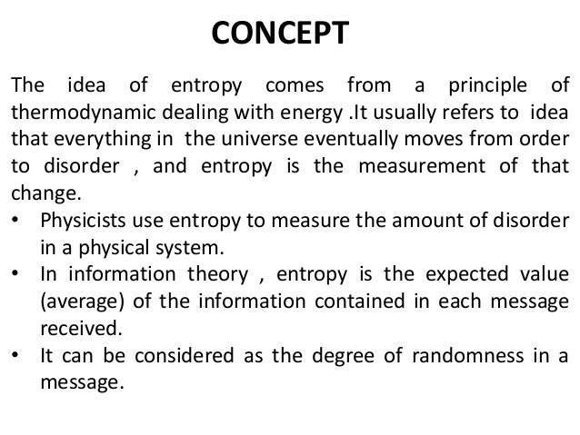

Slide 4
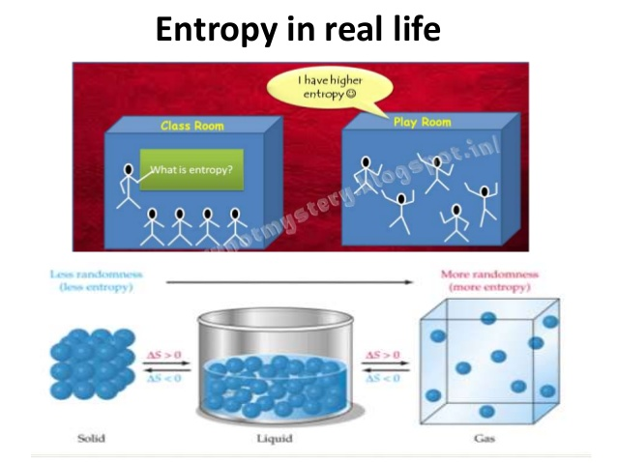

Slide 5
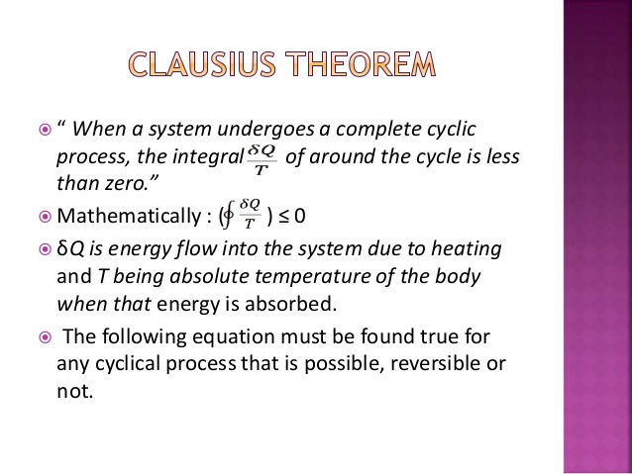

Slide 6
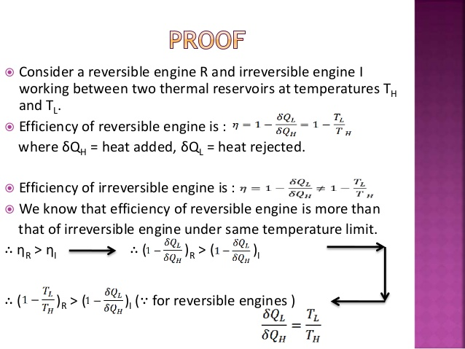

Slide 7
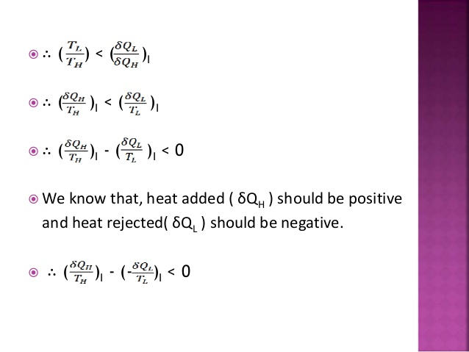

Slide 8
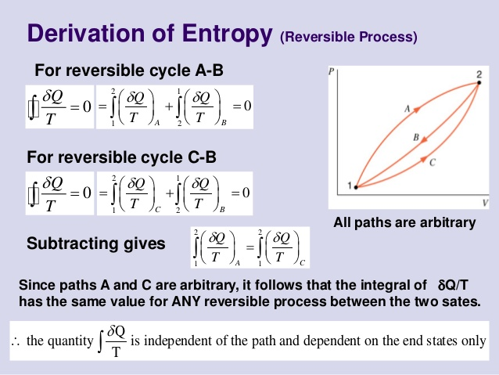

Slide 9
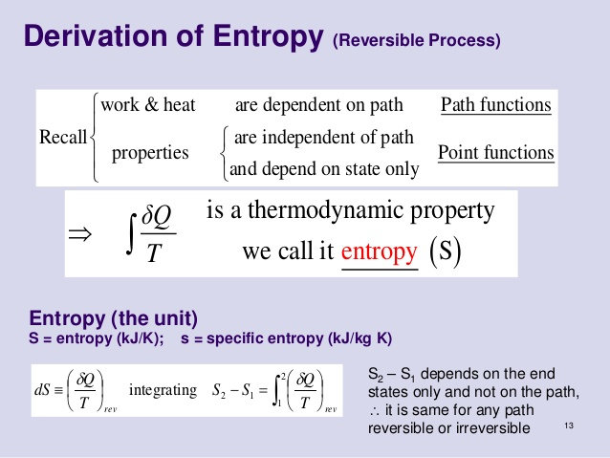

Slide 10
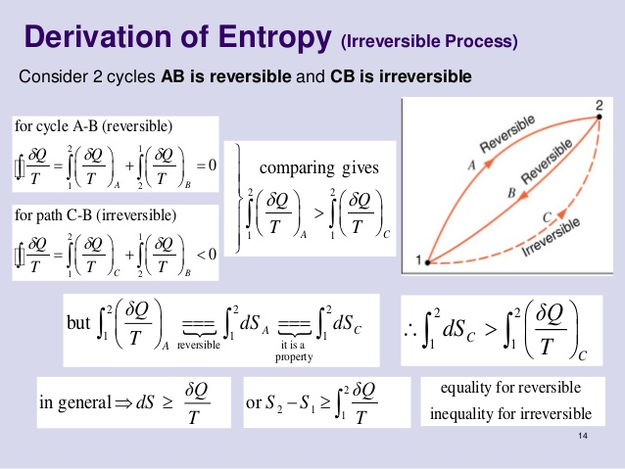

Slide 11
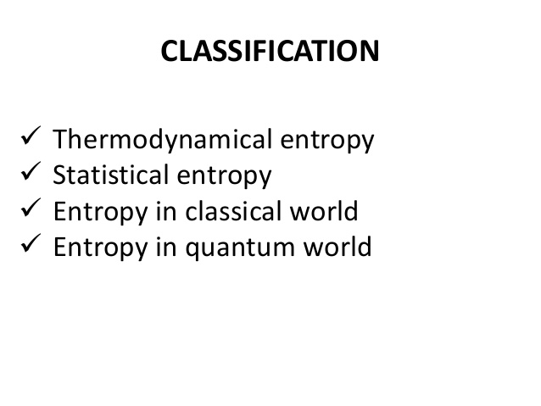

Slide 12
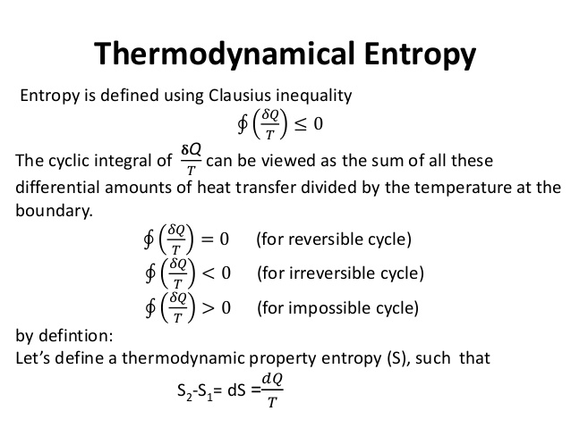

Slide 13
Principle of INCREASE OF entropy
Thus the Increase in Entropy Principle states that for any process total change in entropy of a system together with its enclosing adiabatic surroundings is always greater than or equal to zero.
Irreversible or spontaneous processes can occur only in that direction for which the entropy of the universe or that of an isolated system, increases. These processes cannot occur in the direction of decreasing entropy.
For an isolated system,
δS > 0, for irreversible processes
δS = 0, for reversible processes
δS < 0, the process is impossible

Slide 14
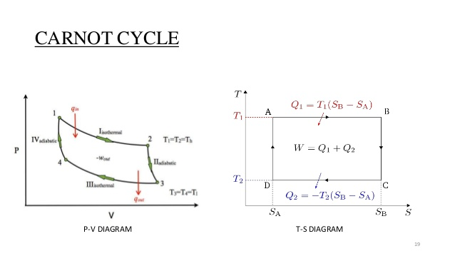

Slide 15
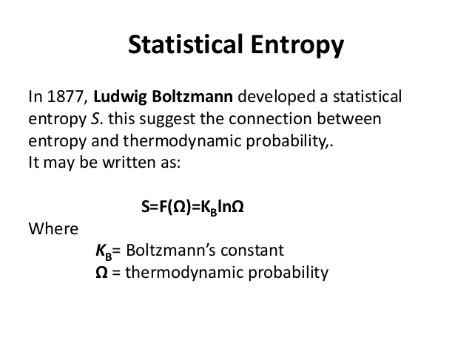

Slide 16
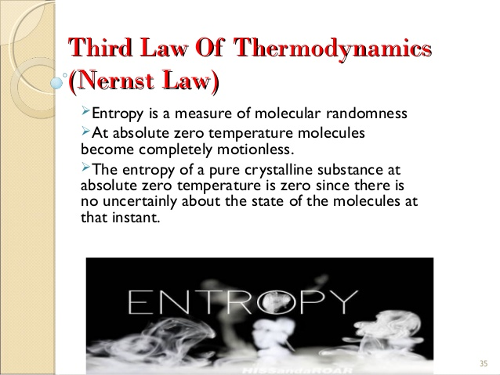

Slide 17
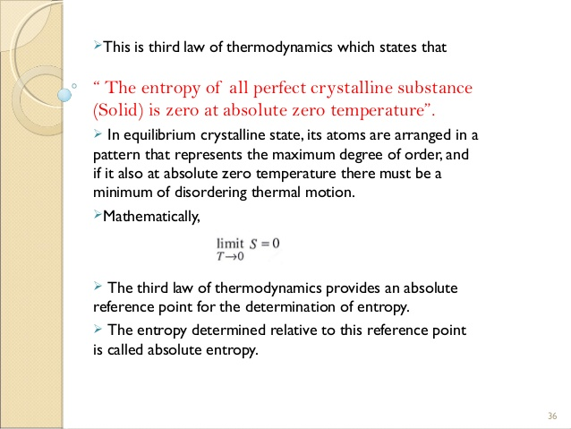

Slide 18
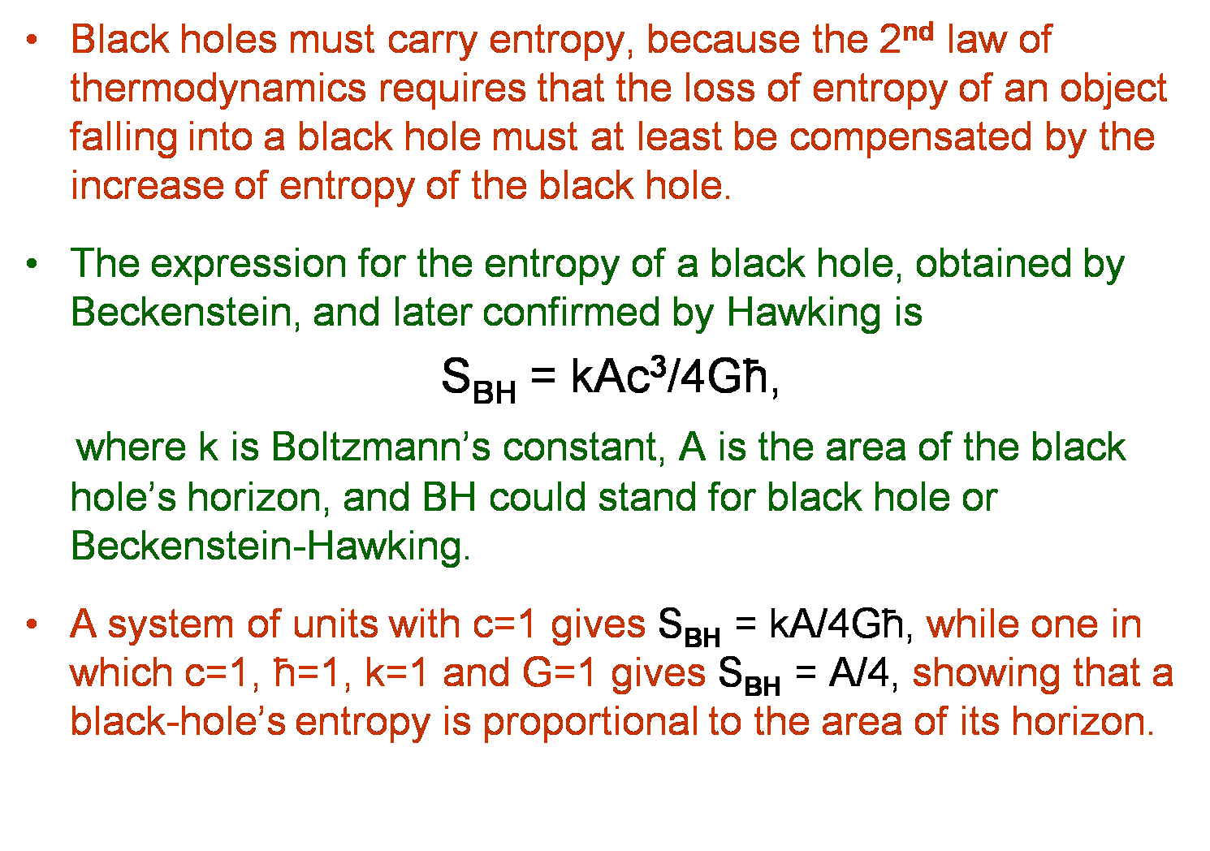
BLACK HOLE & ENTROPY

Slide 19
THE END

